Slide 1
FOOD DEMAND FORECASTING FOR FOOD DELIVERY COMPANY USING IBM CLOUD

Slide 2
INTRODUCTION
Demand forecasting is a key component to every growing online business. It is the process in which historical data is used to estimate the quantity of product customer will purchase. This prediction activity is used in many fields like retailing, food industry etc. Without proper demand forecasting processes in place,it can be nearly impossible to have the right amount of stock on hand at any given time. A food delivery service has to deal with a lot of perishable raw materials which makes it all the more important for such a company to accurately forecast daily and weekly demand. Too much inventory in the warehouse means more risk of wastage,and not enough could lead to out-of-stocks - and push customers to seek solutions from your competitors

Slide 3
PROBLEM STATEMENT
Your client is a meal delivery company which operates in multiple cities.They have various fulfillment centers in these cities for dispatching meal orders to their customers. The client wants you to help these centers with demand forecasting for upcoming weeks so that these centers will plan the stock of raw materials accordingly. The replenishment of majority of raw materials is done on weekly basis and since the raw material is perishable,the procurement planning is of utmost importance.Secondly, staffing of the centers is also one area wherein accurate demand forecasts are really helpful.Given the following information,the task is to predict the demand for the next 10 weeks(Weeks: 146-155) for the center-meal combinations in the test set: t
● Historical data of demand for a product-center combination(Weeks:1 to 145)
● Product(Meal) features such as category,sub-category,current price and discount
● Information for fulfillment cener like center area, city information etc.

Slide 4

EVALUATION METRIC
100 * Root of Mean Squared Logarithmic Error (RMSLE)

Slide 5
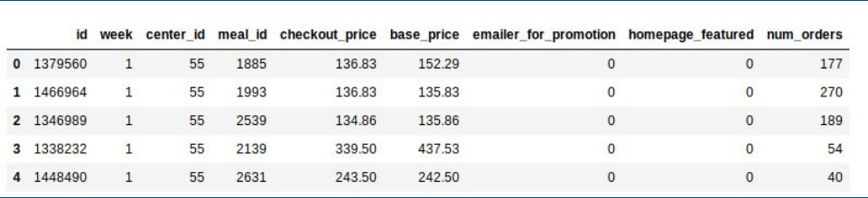
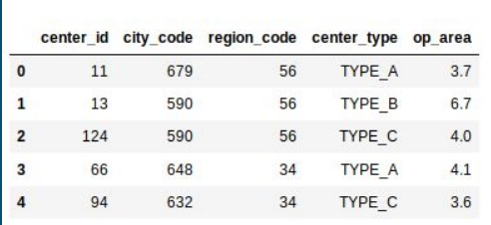
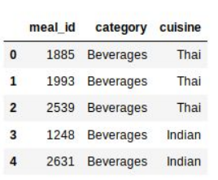
DATASET
.
.

Slide 6
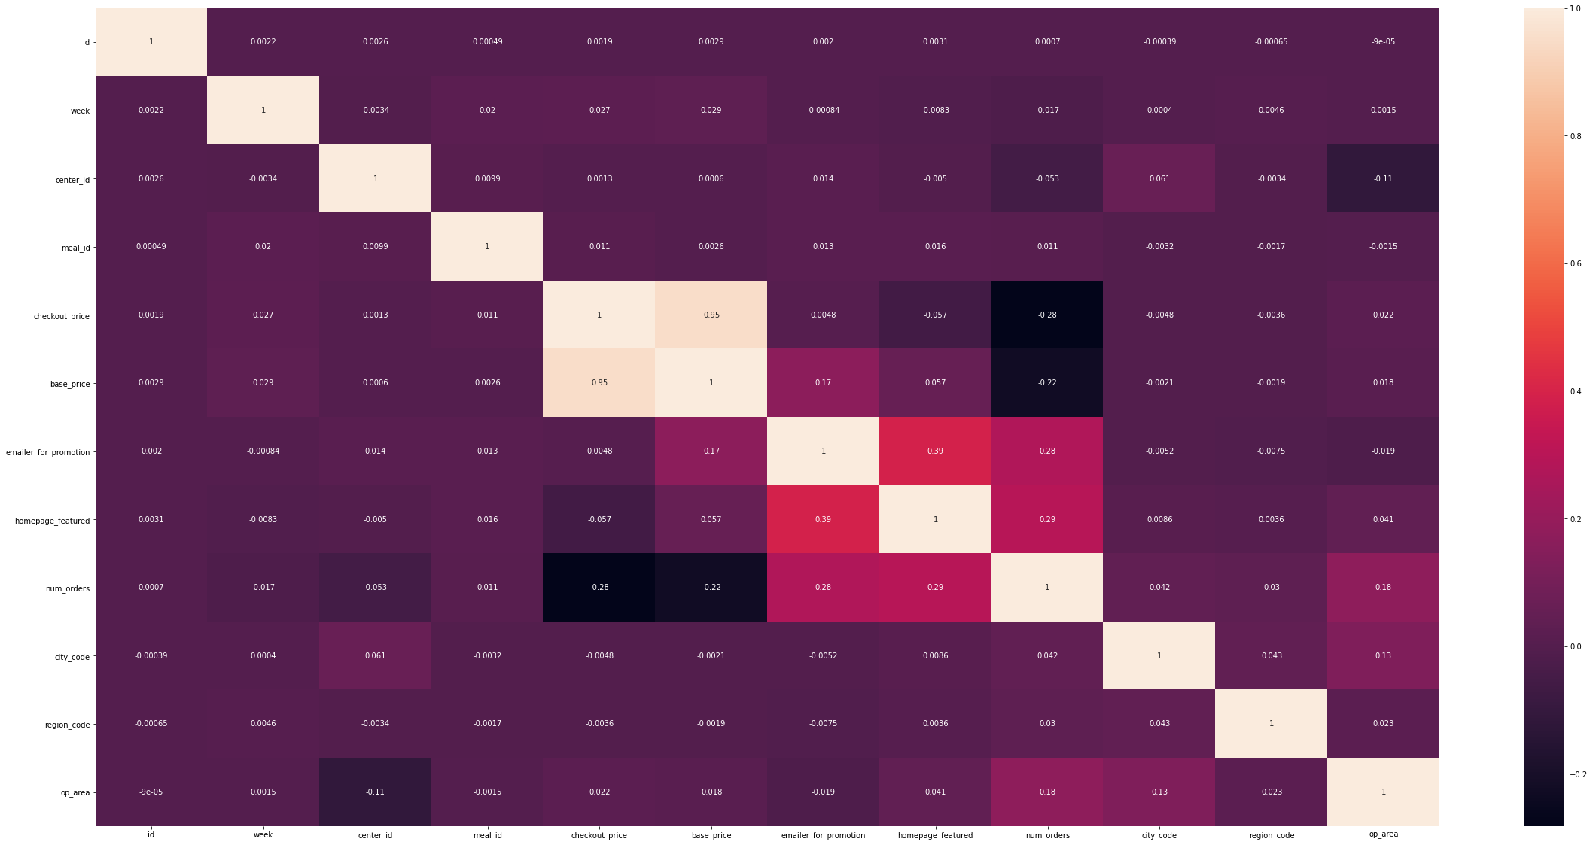
OVERALL TREND ANALYSIS
.

Slide 7
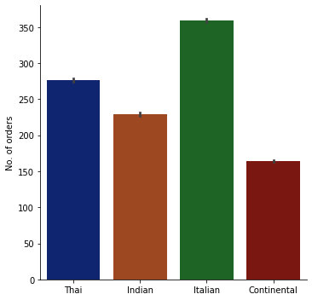
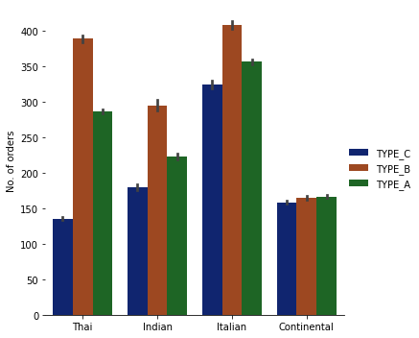
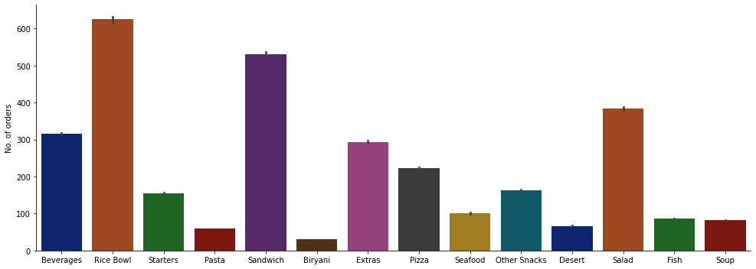
.

Slide 8
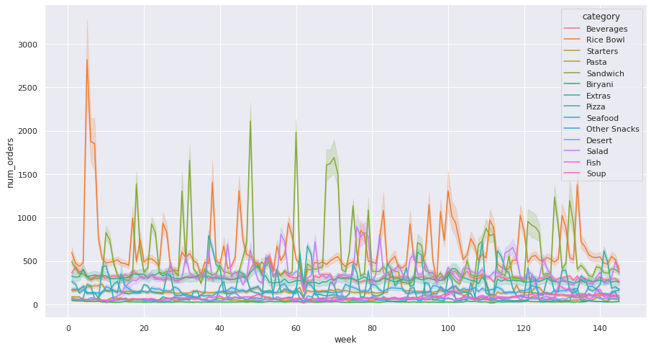
.

Slide 9
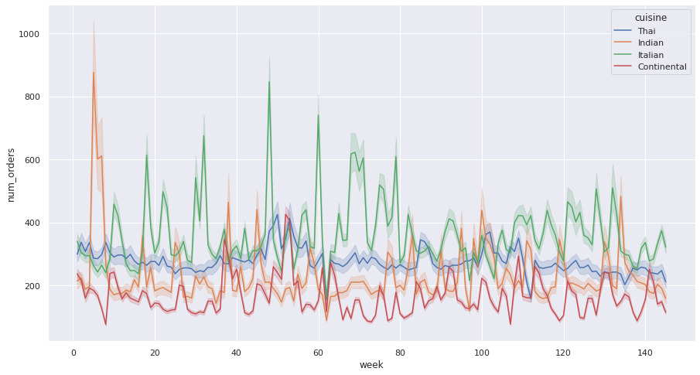
.

Slide 10
MODEL BUILDING
The main work done here is of applying the different algorithms on the training set and checking the accuracy of the model on the basis of these algorithms. The evaluation is done using RMSE values.

Slide 11
APPLICATION BUILDING
In this section we have built a web application to integrate the ML model which we built. A UI is built for the user to enter the input details ie; feature variables for predicting the total order volume of the particular product at a center and locality. Once the input is received it is then fed into the model for prediction purpose after which the result will be printed in the same page.

Slide 12
THANK YOU!!

